Slide 1

Lab 7: HAMMING CODE
CSE 2301 – Fall 2024

Slide 2
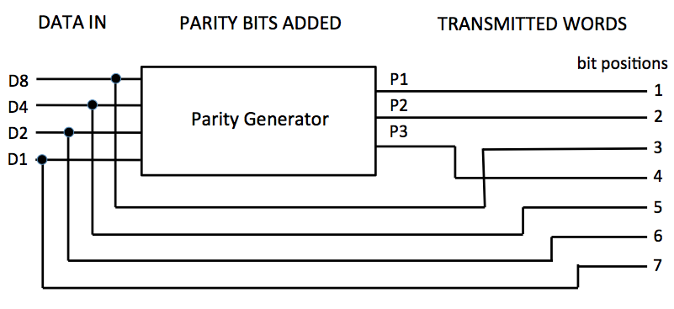
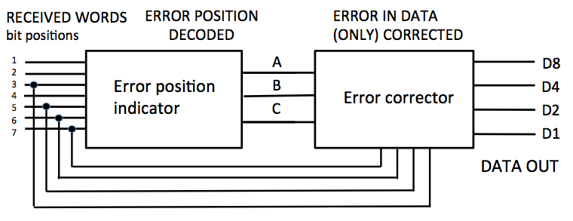
Introduction: overview
You will be developing two circuits today. In the first, you will generate parity bits from a 4-bit code, and in the second, you will be taking a 7-bit parity code, checking it for errors, and then fixing it if necessary. These two steps constitute separate symbols.
You will be working with symbols once again to create the parity generator, error position indicator, and error corrector. Refer to lab 4 instructions if you need a refresher.

Slide 3
REVIEW: hamming code
Bit positions
1
2
3
4
5
6
7
Hamming codes add parity bits for error checking. With the hamming distance seen here (3), we can check for and correct one error.
Note the names we give the parity and data bits here. They represent weights.
Weighted 4-bit data word
D8
D4
D2
D1
Parity bit positions - interspersed
P1
P2
P4

Slide 4
Part 1: PARITY bit generator
Parity Bit | Based on Data Bits
P1 | D8, D4, D1
P2 | D8, D2, D1
P3 | D4, D2, D1
You’ve probably done enough work by now to know that each parity bit is encoded based on whether or the sum of three of the parity bits is even or odd.
What you may not know is how to convert this into a logical circuit.

Slide 5
Part 1: PARITY BIT generator
3 data bits |  |  | Even parity bit
X | Y | Z | P
0 | 0 | 0 | 0
0 | 0 | 1 | 1
0 | 1 | 0 | 1
0 | 1 | 1 | 0
1 | 0 | 0 | 1
1 | 0 | 1 | 0
1 | 1 | 0 | 0
1 | 1 | 1 | 1
The truth table shows how you might reduce the equation to determine the output of each parity bit based on three inputs (as described on the previous page).
This seems overly complicated, doesn’t it?
P = X’Y’Z + X’YZ’ + XY’Z’ + XYZ

Slide 6
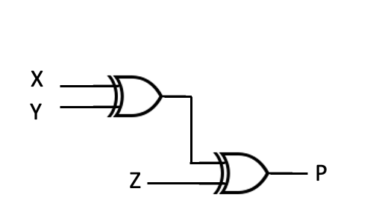




Part 1: PARITY bit generator
P = X’(Y’Z + YZ’) + X(Y’Z’ + YZ)
= X’(Y Z) + X(Y Z)’
= X Y Z
$$⨁$$
$$⨁$$
Using some Boolean algebra, we can simplify this greatly. This leads to a lemma of sorts: the XOR of multiple variables will tell us whether their sum is even (0 if even, 1 if odd).
$$⨁$$
$$⨁$$

Slide 7
Part 2: ERROR CHECKING & Correcting
We can only detect and fix single errors. Remember how XOR will tell us if the sum is even or odd? In this case, if the check code bit is odd, something must be wrong, because we should see only even output.
The parity bits have weights indicating the position of the error.
P1 D8 D4 D1 generate check code bit A
P2 D8 D2 D1 generate check code bit B
P3 D4 D2 D1 generate check code bit C
P1
P2
D8
P3
D4
D2
D1

Slide 8

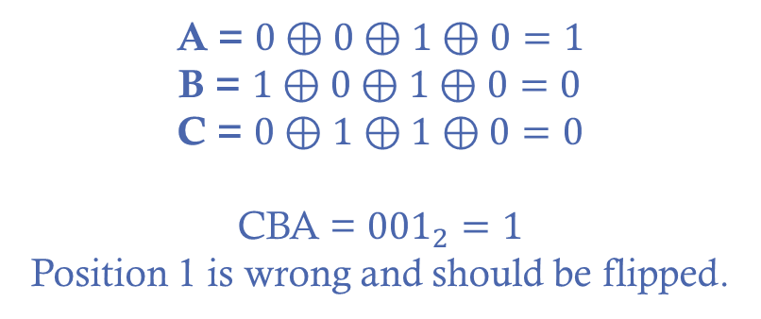
Part 2: EXAMPLE check
P1 D8 D4 D1 generate check code bit A
P2 D8 D2 D1 generate check code bit B
P3 D4 D2 D1 generate check code bit C
Generate the check does first. This will tell you the positions that are in error.
You will then need to define the functionality of the error corrector to take the 4 data bits from the parity code and the CBA check bits to fix the bit in error. Recall that you can dynamically flip a bit by XORing it with 1.
0
1
0
0
1
1
0
$$6_{10}$$
A = $0⊕0⊕1⊕0=1$
B = $1⊕0⊕1⊕0=0$
C = $0⊕1⊕1⊕0=0$
CBA = ${001}_{2}=1$
Position 1 is wrong and should be flipped.

Slide 10

Other notes AND report information
The report for this lab is light, but relevant for the next exam.
Good luck!

